Slide 1
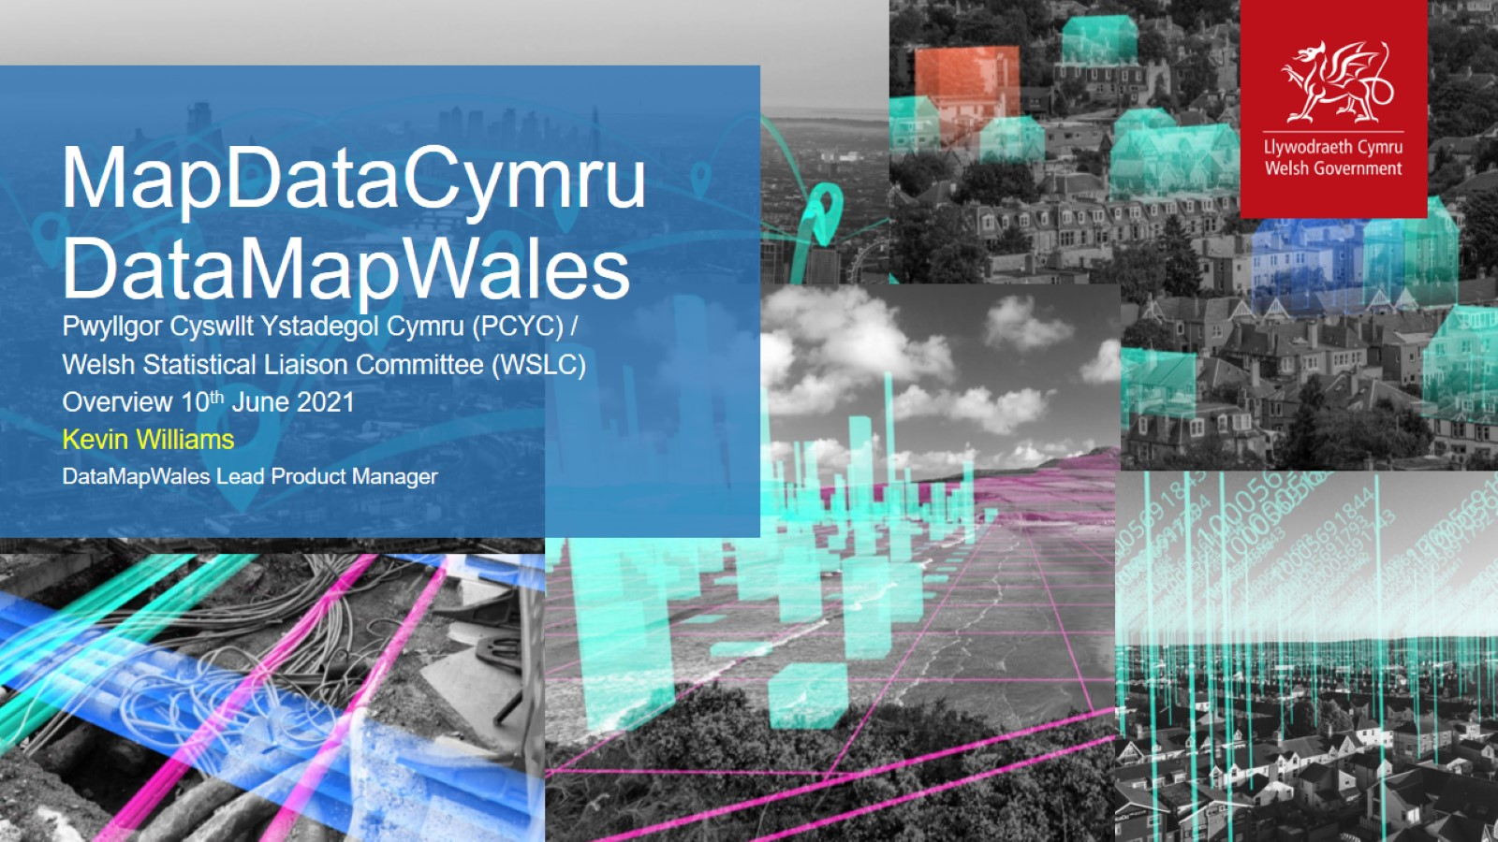
MapDataCymru DataMapWales

Slide 2
Vision

Slide 3
Overview

Slide 4
Spatial Data Infrastructure Open Geospatial software stack

