Slide 1
Welsh Statistical Liaison Committee
LFS/APS
Salah Merad and Martina Helme,
Office for National Statistics, UK
salah.merad@ons.gov.uk
martina.helme@ons.gov.uk
7th October 2021

Slide 2
Outline
Brief overview of LFS/APS sample design and weighting
Changes to the LFS since the start of the pandemic
Impact on LFS response and sample bias
Adjustments to reduce bias
Implementing the adjustments:
  In LFS - impact on 2020 estimates
  In APS
Future developments

Slide 3
Brief overview of APS/LFS sample design and weighting

Slide 4

LFS Sample
Around 75,000 households sampled each quarter for the LFS and around 40,000 households take part
This equals around 90,000 individuals
every quarter
Sample intended to be representative of the
entire population
Therefore each case weighted by age, sex and
geography
65 million people ÷ 90,000 = each respondent is
equivalent to approximately 800 people
75+ households and multiple households will
have much larger weights
The LFS is not of a sufficient size to allow for analysis at below Regional level

Slide 5
APS Sample
Main purpose of the APS is that analysis can be conducted at Local Authority level
The ‘boost’ cases ensure a set number of cases for each Local Authority are targeted
In Wales and inc. LFS main sample each quarter contains:
- around 14,000 household interviews
- around 25,000 individual interviews

Slide 6
LFS wave structure
JM20
Wave 1
Wave 2
Wave 3
Wave 4
Wave 5
Respondents are interviewed for five successive
waves at three-monthly intervals
20% of the sample is replaced every quarter
AJ20
Wave 1
Wave 2
Wave 3
Wave 4
Wave 5
JS20
Wave 1
Wave 2
Wave 3
Wave 4
Wave 5
OD20
Wave 1
Wave 2
Wave 3
Wave 4
Wave 5
JM21
Wave 1
Wave 2
Wave 3
Wave 4
Wave 5

Slide 7
LFS boost wave structure
2017
Wave 1
Wave 2
Wave 3
Wave 4
England, Scotland and Wales all fund Local Labour Force Survey interviews (LLFS, Boost or Enhancement cases)
Respondents are interviewed for four successive
waves at 12-monthly intervals
25% of the sample is replaced every quarter
2018
Wave 1
Wave 2
Wave 3
Wave 4
2019
Wave 1
Wave 2
Wave 3
Wave 4
2020
Wave 1
Wave 2
Wave 3
Wave 4
2021
Wave 1
Wave 2
Wave 3
Wave 4

Slide 8
APS wave structure
The APS is made up of LFS W1 and W5, and the LFS Boost W1-4
2017
LFS W1
LFS W5
Boost W1
Boost W2
Boost W3
Boost W4
2018
LFS W1
LFS W5
Boost W1
Boost W2
Boost W3
Boost W4
2019
LFS W1
LFS W5
Boost W1
Boost W2
Boost W3
Boost W4
2020
LFS W1
LFS W5
Boost W1
Boost W2
Boost W3
Boost W4
2021
LFS W1
LFS W5
Boost W1
Boost W2
Boost W3
Boost W4

Slide 9
LFS sample design and weighting
The LFS is a rotating panel probability sample survey (5 waves in each quarter)
Non-responders in wave k, k=2,…,5, who responded in wave k-1, are imputed
The data are weighted to the UK resident population by age, sex and geography
Students in halls of residence are part of the population but their data are collected from parents
The population totals for the groups used in weighting are obtained from population projections by single year of age in each local authority that are based on mid-year population estimates

Slide 10
Changes to the LFS data collection since the start of the pandemic

Slide 11
Timeline of events
17/03
F2F data collection suspended
30/03
Telephone interviewing rolled out to F2F interviewers
01/07
W1 sample size doubled
23/03
UK lockdown begins
09/03
Public awareness starts affecting survey participation
20/04
Online portal for telephone details
01/04
Roll-out of ‘Knock-to-Nudge’ alongside W1 sample reduction

Slide 12
What is ‘Knock to Nudge (KtN)’?
Cases without phone contact details are assigned to an F2F interviewer
Interviewer will make 3 call attempts to obtain phone contact details at the doorstep followed by a telephone interview if successful
KtN is currently conducted on wave 1 cases, but only on wave 2-5 where phone contact details were incorrect or supplied late.
Notes:
Slide 11 and 13 show the positive impact that KtN had on RR change, and distribution of characteristics of respondents.

Slide 13
Impact on response and sample bias

Slide 14
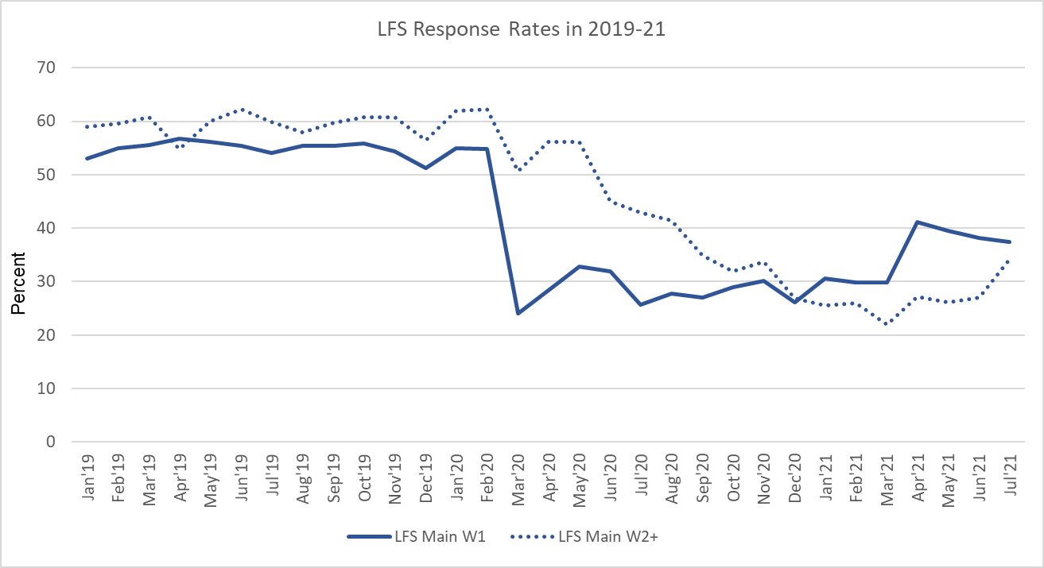
Impact of COVID-19 on LFS Response Rates
Notes:
With beginning of March’20 response rates for the LFS W1 sample considerably dropped to between 25 to 30%. This remained low tun April’21 when we introduced ‘Knock to Nudge’ which brought W1 response rates up to around 40%. This is because only cases where no phone numbers are available were subject to ‘Knock to Nudge’.
Response rates for W2+ behaved differently. This part of the sample was not hit as hard by the onset of the pandemic because we already had contact details of householders, which is why it was easy to follow up. Response rates did decline though over time because unproductive W1 cases were rolled forward into the second wave to attempt them again and often these where then unproductive again. We can see an improvement of response rates in July and this is because interviewers were now instructed to attempt W2+ cases that were unproductive but had portal numbers (potentially supplied late in previous wave or late)

Slide 15
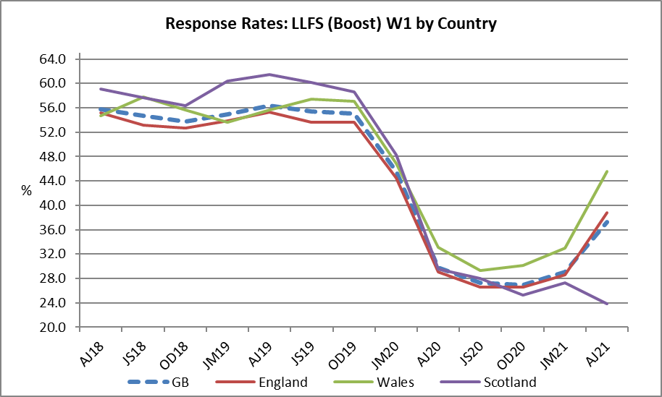
Impact of COVID-19 on LFS Boost RR
Notes:
This graph illustrates the drop in the achieved sample size in the second quarter of 2020. Due to the increase of the sample boost in the third quarter of 2020, the W1 sample size recovered to 2019 levels or above. With April’21 we reduce the issued W1 sample again (so not doubled buy only increased by 60%) whilst rolling out KtN, and this graph shows that we were able to maintain the level of achieved sample due to the increase in response rate achieved with KtN.

Slide 16
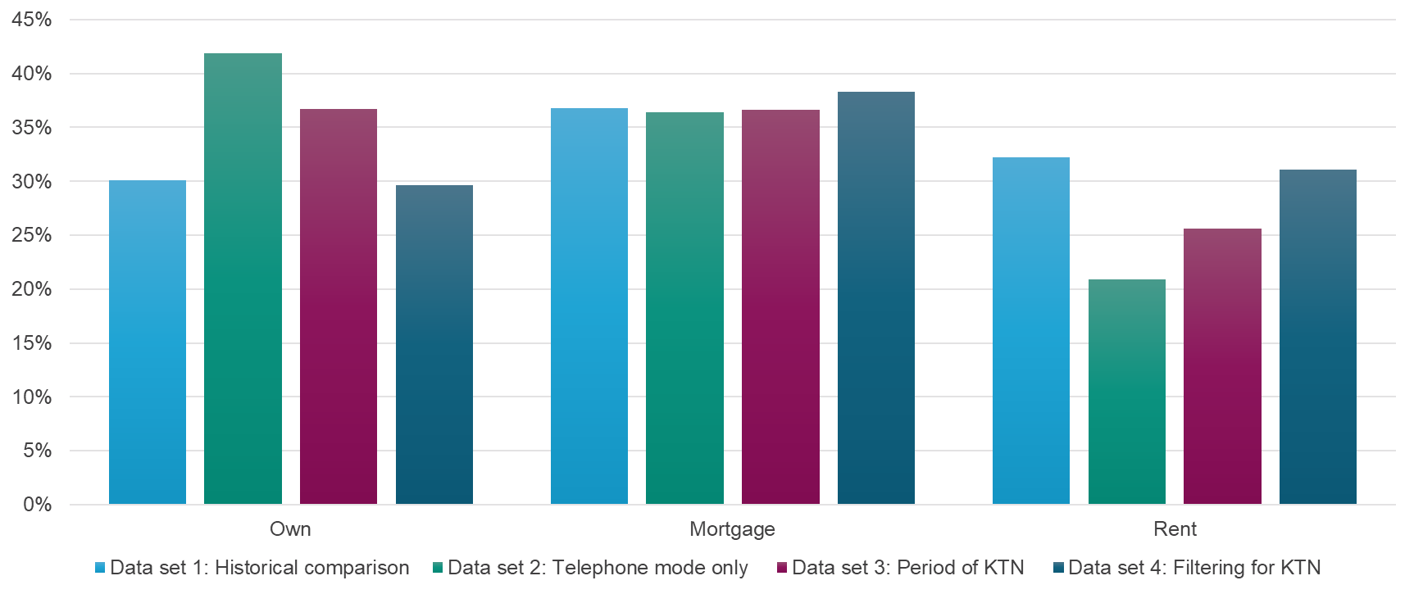
Impact on Tenure distribution
Notes:
The change in non-response bias was significantly evident in a change to the housing tenure of the Household Reference Person, with a lower proportion of rented addresses being included and an increase in the proportion of those owned outright by the occupier. Here you can see the distribution of tenure amongst W1 respondents.
The time series changed between February and March 2020 when the pandemic started and we switched from F2F to telephone interviewing at W1, meaning it was more difficult to get respondents that are harder to reach recruited into the sample.
The second change (even though less pronounced) is visible in April 2021 when KtN was introduced. The change was not as big as when we switched mode in March 2020, because KtN is only applied to those cases where no phone number was obtained, but it has gone in the right direction.

Slide 17
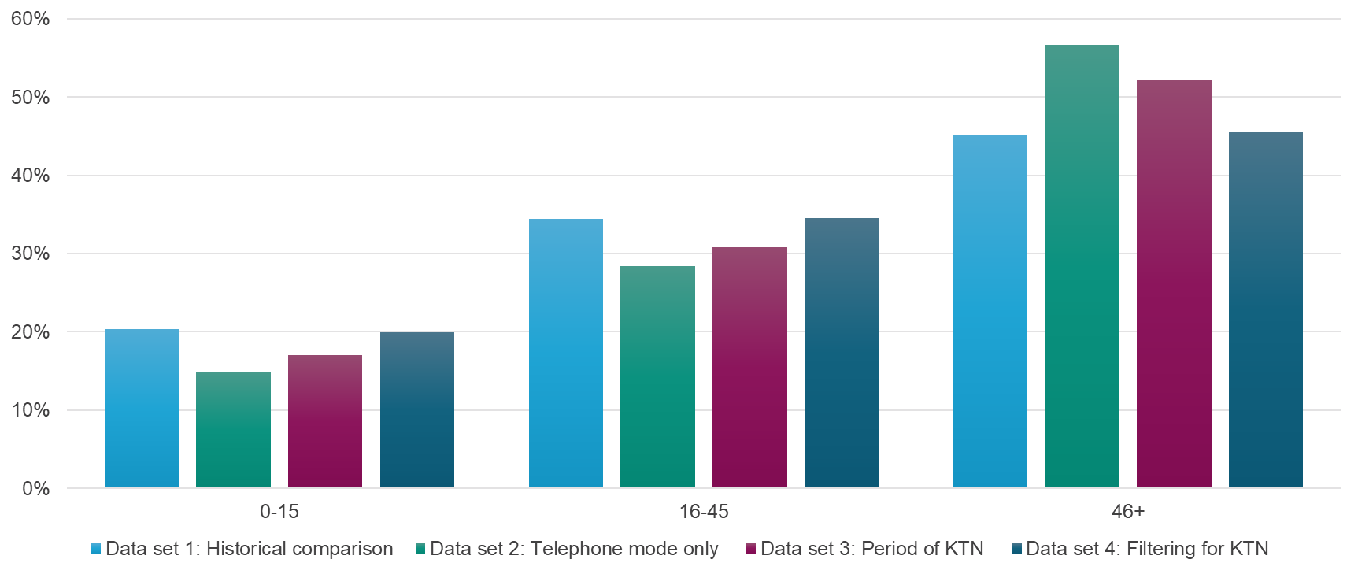
Impact on Age distribution
Notes:
The change in non-response bias was significantly evident in a change to the housing tenure of the Household Reference Person, with a lower proportion of rented addresses being included and an increase in the proportion of those owned outright by the occupier. Here you can see the distribution of tenure amongst W1 respondents.
The time series changed between February and March 2020 when the pandemic started and we switched from F2F to telephone interviewing at W1, meaning it was more difficult to get respondents that are harder to reach recruited into the sample.
The second change (even though less pronounced) is visible in April 2021 when KtN was introduced. The change was not as big as when we switched mode in March 2020, because KtN is only applied to those cases where no phone number was obtained, but it has gone in the right direction.

Slide 18
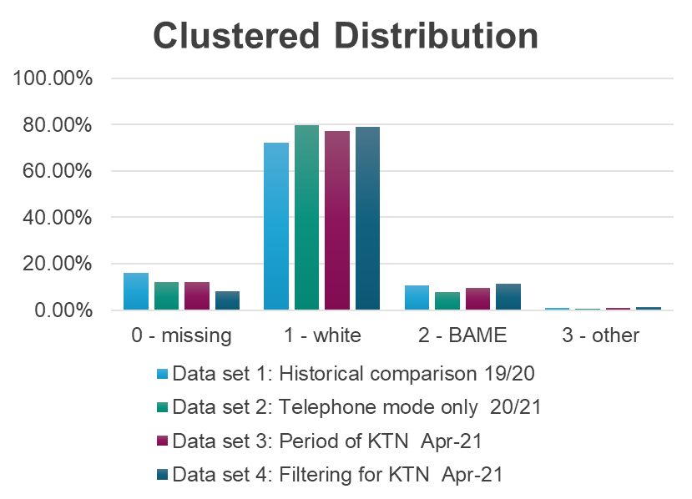
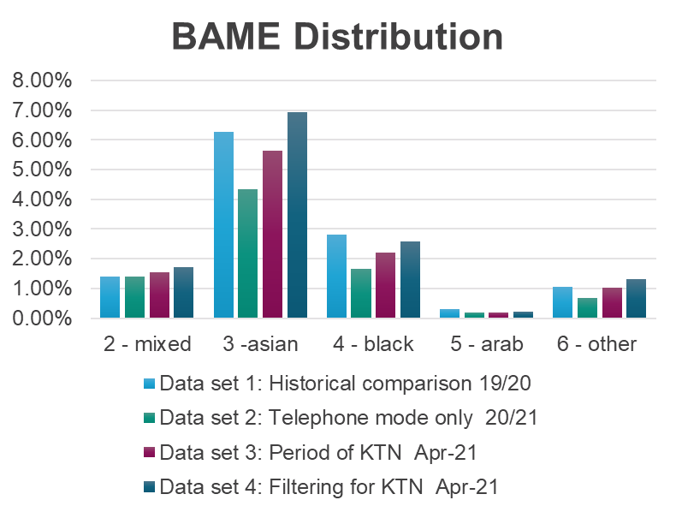
Impact on Ethnicity distribution
Notes:
The change in non-response bias was significantly evident in a change to the housing tenure of the Household Reference Person, with a lower proportion of rented addresses being included and an increase in the proportion of those owned outright by the occupier. Here you can see the distribution of tenure amongst W1 respondents.
The time series changed between February and March 2020 when the pandemic started and we switched from F2F to telephone interviewing at W1, meaning it was more difficult to get respondents that are harder to reach recruited into the sample.
The second change (even though less pronounced) is visible in April 2021 when KtN was introduced. The change was not as big as when we switched mode in March 2020, because KtN is only applied to those cases where no phone number was obtained, but it has gone in the right direction.

Slide 19
Adjustment to reduce bias

Slide 20
Weighted distribution of household tenure

Slide 21
Adjustments to weighting
There is no explicit non-response adjustment in current weighting method
We introduced additional calibration constraints
  Uniform weekly distribution of weighted sample by country
  Distribution of tenure set to the average of 2019 distribution
  Assumes minor structural change to the population
  Assumes available population projections to be fairly accurate

Slide 22
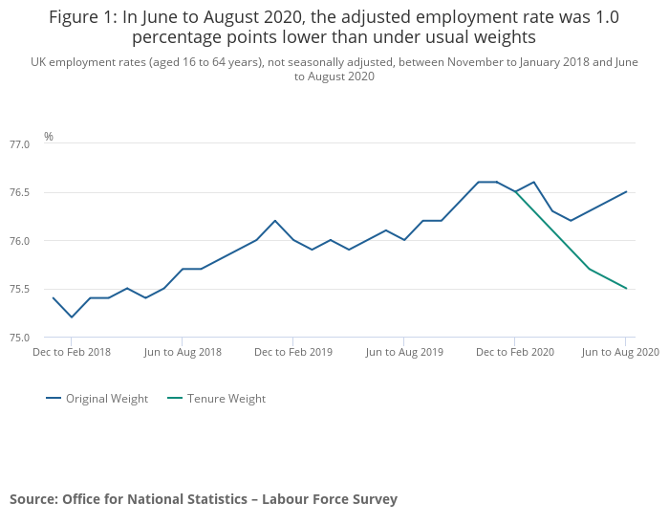

Slide 23
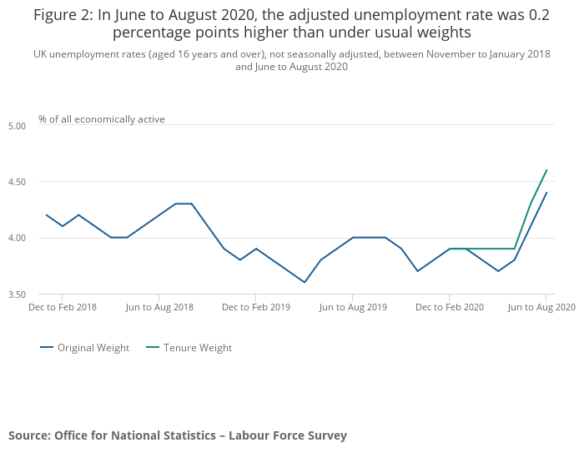

Slide 24
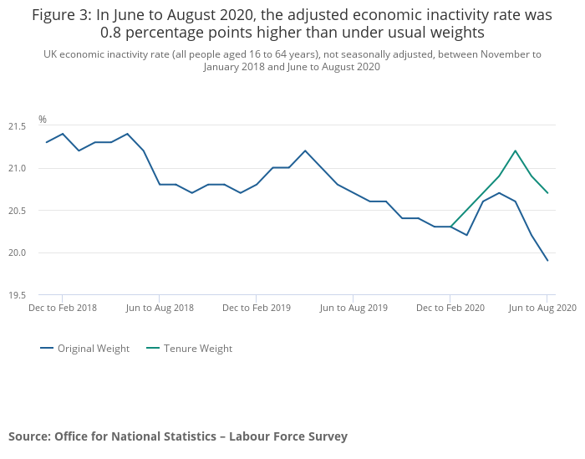

Slide 25
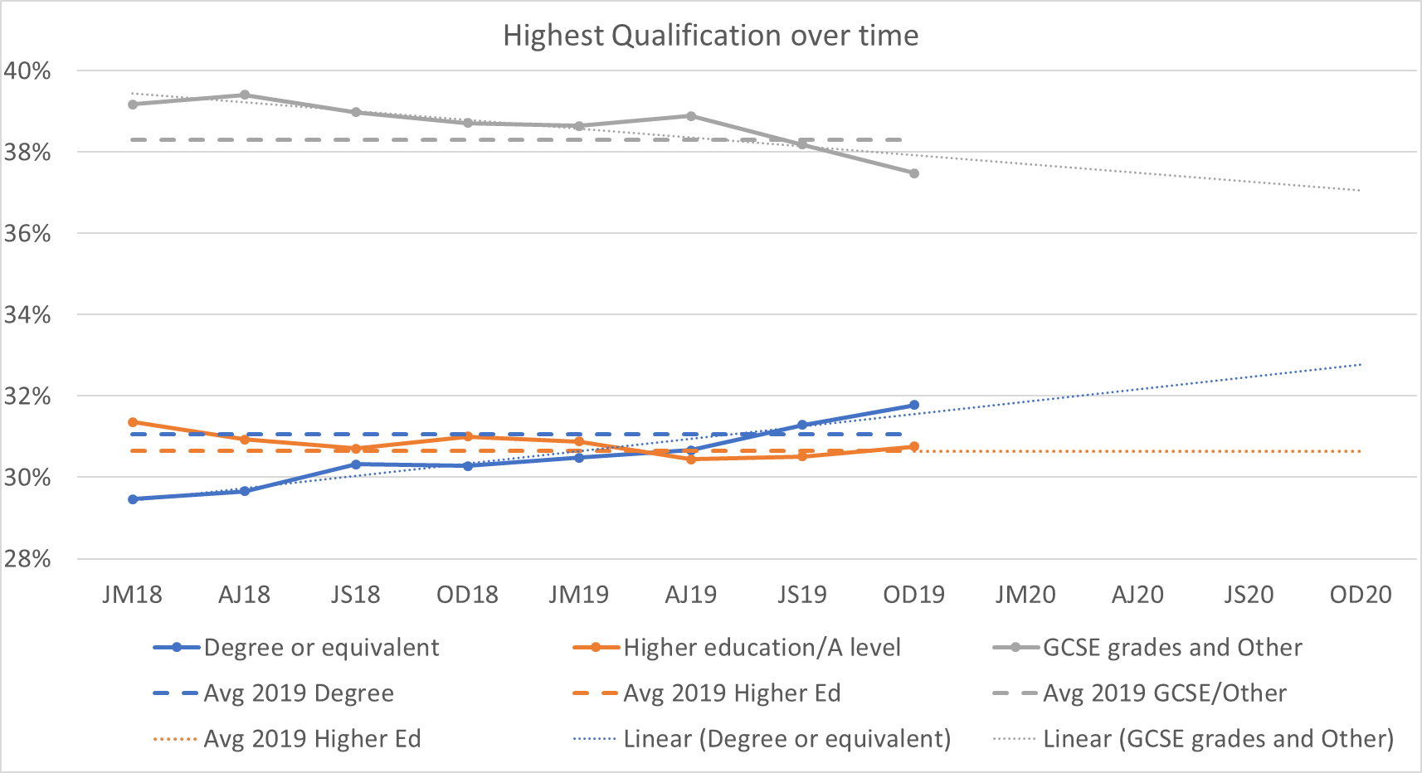
Considering other socio-economic variables: Highest qualification

Slide 26
Impact of pandemic on LFS estimates by country of birth
Published estimates of employment by country of birth before recent reweighting
Estimates by country of birth look implausible from April 2020 onwards

Slide 27
Impact of pandemic on non-UK born population
Using all cases
Excluding imputed cases and wave 1 cases after mid-March 20 (75+ only)

Slide 28
Attrition analysis
Attrition rates decreased in UK born after pandemic but increased in non-UK born in all age groups
EU born dropped out more out of sample than non-EU born

Slide 29
Comparing LFS and RTI based estimates of growth (from HMRC, an administrative source )
LFS-based growth rates for non-UK decreased much more between Oct-Dec 19 and in Jul-Sep 20 than RTI-based growth rates
It’s very likely that LFS estimates suffer from bias stemming from differential non-response between UK and non-UK born that the additional tenure constraint hasn’t reduced sufficiently
We need to reduce this bias by adding a constraint on the structure of the population by country of birth

Slide 30
How can we use RTI data to estimate EU and non-EU born subpopulations?
We want to estimate year-on-year population growth in each rolling quarter in 2020 onwards
Very few observations from RTI are available to fit a statistical model
Use simple assumptions to derive an expression of change in population growth rates in terms of change in RTI-based employee growth rates
  Oct-Dec 2019 (OD19) is the base period: Population growth is know
Assumptions
  change in the population growth rate of the non-UK sub-populations is in the same direction as the change in their RTI employee growth rate
  the magnitude of change in population growth rate does not exceed that of change in RTI employee growth rate
We consider July-September 2020 (JS20)

Slide 31
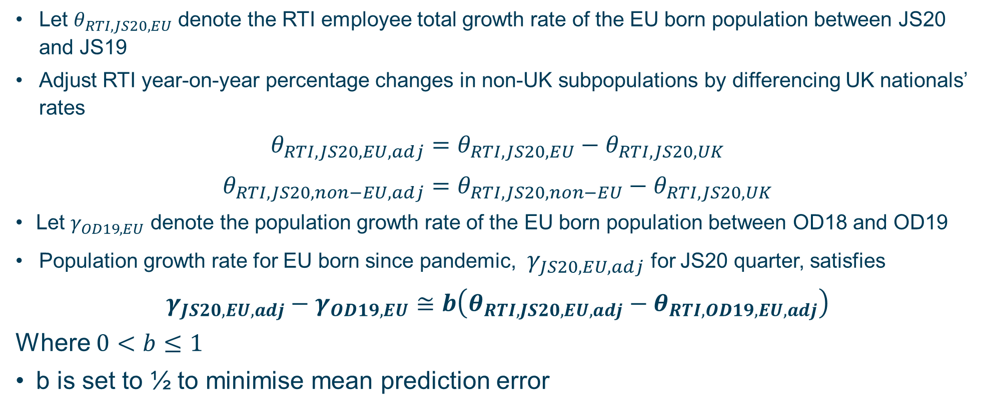
Method
Let $θ_{RTI,JS20,EU}$ denote the RTI employee total growth rate of the EU born population between JS20 and JS19
Adjust RTI year-on-year percentage changes in non-UK subpopulations by differencing UK nationals’ rates
$$θ_{RTI,JS20,EU,adj}=θ_{RTI,JS20,EU}−θ_{RTI,JS20,UK}$$
$$θ_{RTI,JS20,non−EU,adj}=θ_{RTI,JS20,non−EU}−θ_{RTI,JS20,UK}$$
Let $γ_{OD19,EU}$ denote the population growth rate of the EU born population between OD18 and OD19
Population growth rate for EU born since pandemic, $γ_{JS20,EU,adj}$ for JS20 quarter, satisfies
$$γ_{JS20,EU,adj}−γ_{OD19,EU}≅b\left(θ_{RTI,JS20,EU,adj}−θ_{RTI,OD19,EU,adj}\right)$$
Where $0<b≤1$
b is set to ½ to minimise mean prediction error

Slide 32
Evaluation using past RTI data and long-term international migration estimates (LTIM)

Slide 33
Impact on the population size by country of birth
LFS year-on-year change in population levels by country of birth –
Figures in 1000s

Slide 34
Implementing the adjustments in LFS

Slide 35
Reweighting method for LFS
Separated sample into two parts: affected and unaffected by pandemic
Applied a non-response adjustment to the affected part via a regression model that uses the area level factors IMD, OAC and Region
The two parts were then combined before running the calibration
Population totals for the non-UK born (EU and non-EU) were obtained by adjusting the weights of the previous year’s LFS dataset by using the modelled population growth rates
The UK born population was adjusted by applying a growth rate based on natural change
The age, sex and geographical distributions used in weighting were based on population projections
Added HH Tenure, weekly distribution and population size COB by region

Slide 36
Impact on economic activity estimates
A non-response adjustment was applied to cases that joined the sample after the change in data collection using area level data from the census

Slide 37
Reweighting method for APS
Dataset was separated into quarterly subsets
Non-response adjustment was applied to quarters containing data affected by the pandemic (from Jan 20)
The quarterly subsets were combined into a single dataset
Calibration using the following partitions
  Sex by DVAGE16 by EW_GrossingArea
  LA by working age
  GOR by sex by young age
  GB by quarter by week (totals from reweighted LFS)
  Household tenure (2019 LFS data)
  COB by GOVTOF (totals from reweighted LFS)

Slide 38
Future developments
Consideration of further roll-out of KtN and reintroduction of face-to-face interviewing
Continuing our work to transform population and migration statistics using admin data
As further sources for estimates of the population become available (e.g. Census 2021), performance of LFS reweighting model will be assessed and further reweighting may take place if needed

Slide 39
Thank you
ONS Methodology contact:
Salah.Merad@ons.gov.uk
ONS LFS Survey Research contact:
Martina.Helme@ons.gov.uk

