Slide 1
Notes:
1

Slide 2

Using public data to improve cancer services in Wales
Dr Maddy Young- Insight and Engagement Lead
Mal Colley- Database Systems Officer
Who are Tenovus Cancer Care?
Why do we use data and statistics?
Example of use of ONS data to support our internal activities
Example of use of public data and freedom of information requests to support our public facing activities
Notes:
2

Slide 3
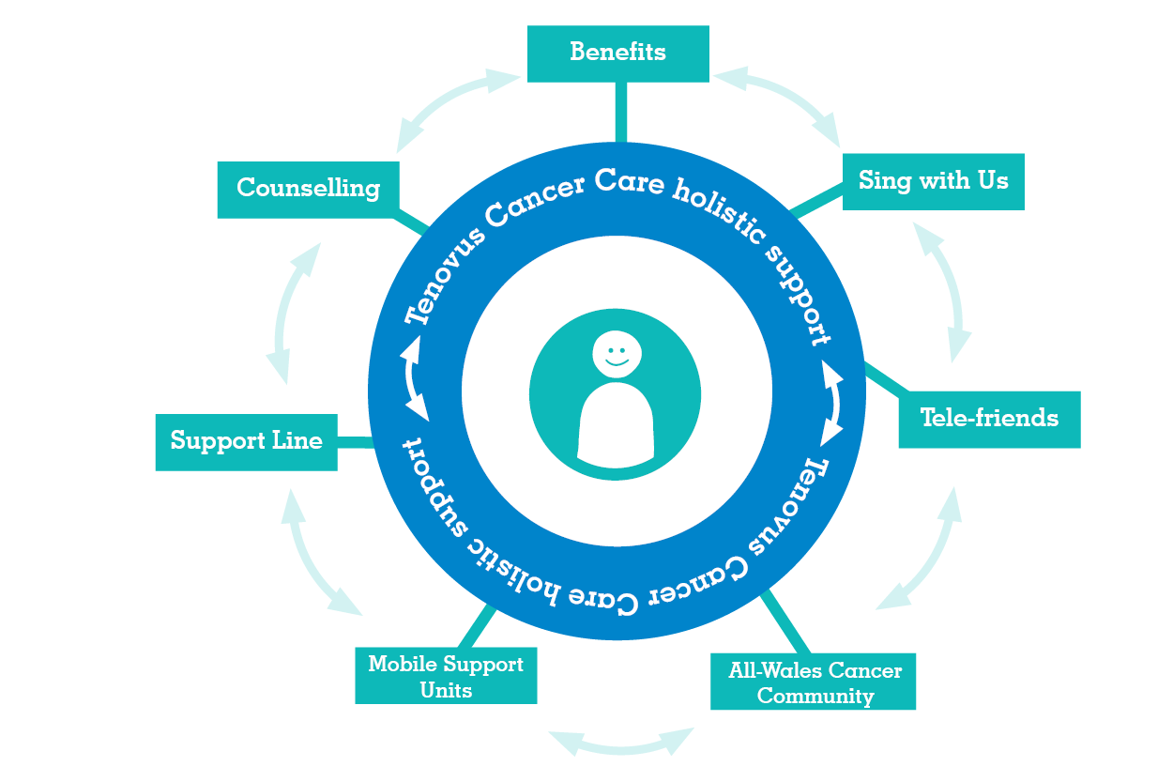
Notes:
Maddy: “In 1943 Tenovus Cancer Care was founded by 10 local businessmen supporting a friend in need. Over the years, Tenovus Cancer Care has grown and changed, but some things have remained constant.”
Constants such as the entire charity sector being under-funded and under-resourced. Which is ever more true now because of austerity, the cost of living crisis, post-Covid-19 recovery, etc. Even for a charity like Tenovus Cancer Care with an average gross income of around £8m p.a. ranking us as a “larger charity”.
To quote Thomas Edison: “necessity is the mother of invention”. One of the charity’s 5 core values is “creative”, defined as “we find creative, innovative solutions”.
“In 2023, we celebrate our 80th birthday and our incredible history of supporting people in the community. In all those years we’ve never lost the values established by our founders in 1943, and continue to embrace a sense of community in everything we do.”
3

Slide 4
Why do we need statistics and data?
Become insight-led
More informed evidence-based decision making;
Faster turnaround for actions benefitting communities in Wales.
Identify organizational priorities
Ensure services are accessible and equitable
More accurate mapping;
Improved grouping and clustering of patients and supporters;
Improve brand recognition and awareness
Longitudinal analyses to tracked engagements over time
Higher open rates (more people reading our communications)
Higher conversion rates (more people interacting with us)
Notes:
4

Slide 5
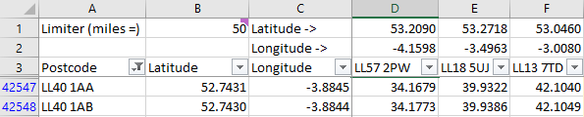
Example of use of ONS data to support our internal activities
Questions:
Which areas have to travel furthest for cancer care?
Are these related to deprivation?
Notes:
5

Slide 6
A Heat Map of our All-Wales Cancer Community
Moving to Power BI for our mapping requirements has progressed us from the old pushpins of Microsoft MapPoint to Heat Maps.
From this map, we identified that we were not reaching as many people living with cancer in some of the Welsh-language heartlands (Anglesey, Gwynedd, Ceredigion, Carmarthenshire) as we had hoped.
This afternoon (9th November 2023) we will be sending out 3 marketing communications (to 7770 people), with extra targeting that should be able to plug some regional gaps.
Notes:
6

Slide 7
Example of use of Welsh Cancer Surveillance and Intelligence Unit data
AIM: To work alongside people affected by cancer to champion their needs, raise awareness of the issues faced and campaign to bring about change, at a national and community level.
Year | Sex | Cancer type | Period | Geography level | Quintile | Count | Crude rate
2019-2021 | Persons | All malignancies excluding NMSC | Three year | Wales | Least deprived | 5035 | 265.13
2019-2021 | Persons | All malignancies excluding NMSC | Three year | Wales | Next least deprived | 5515 | 290.73
2019-2021 | Persons | All malignancies excluding NMSC | Three year | Wales | Middle deprived | 5712 | 301.49
2019-2021 | Persons | All malignancies excluding NMSC | Three year | Wales | Next most deprived | 5431 | 287.25
2019-2021 | Persons | All malignancies excluding NMSC | Three year | Wales | Most deprived | 5412 | 283.24
2019-2021 | Persons | All malignancies excluding NMSC | Three year | Wales | All Wales | 27105 | 285.55
Quintile | Count | Crude rate | Crude rate to count ratio | population | Apply lowest rate to population | Excess deaths in 3 years | Excess deaths in 1 year
Least deprived | 5035 | 265.13 | 18.99068382 | 1899068.382 | 5035 | 0 | 0
Next least deprived | 5515 | 290.73 | 18.96949059 | 1896949.059 | 5029.381041 | 485.619 | 161.873
Middle deprived | 5712 | 301.49 | 18.94590202 | 1894590.202 | 5023.127003 | 688.873 | 229.6243
Next most deprived | 5431 | 287.25 | 18.90687554 | 1890687.554 | 5012.779913 | 418.2201 | 139.4067
Most deprived | 5412 | 283.24 | 19.1074707 | 1910747.07 | 5065.963706 | 346.0363 | 115.3454
All Wales | 27105 | 285.55 | 94.9220802 | 9492208.02 | 25166.69112 | 1938.309 | 646.103
Notes:
7

Slide 8
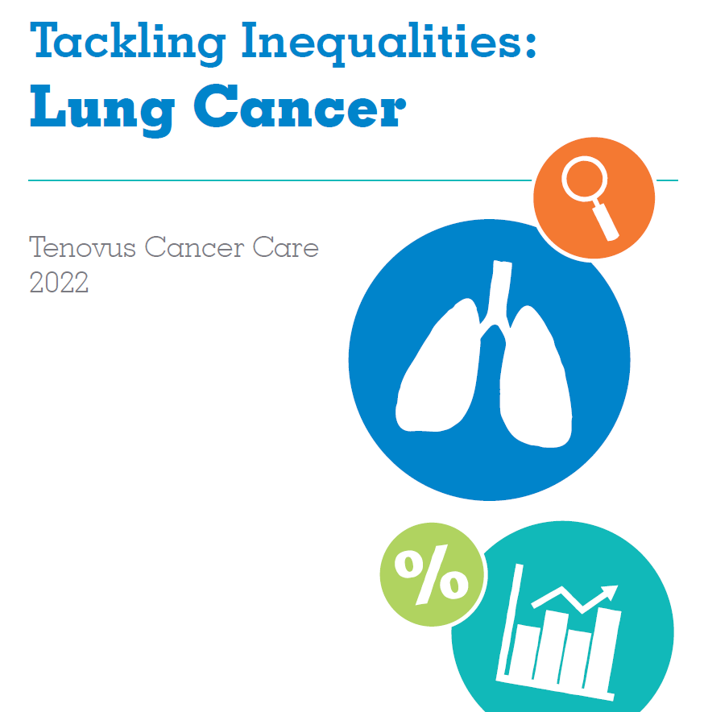
Why is deprivation such a driving factor for cancer deaths?
Lung cancer
About 1800 deaths in Wales a year (of about 9000 a year)
≈555 of these deprivation associated cancer deaths are lung cancer
Why does deprivation cause so many lung cancer deaths?
Older population
Higher levels of co-morbidities
Increased smoking rates
Poorer air quality
Lower help-seeking behaviour
How does this knowledge help us?
We can plan our priorities and activities

Slide 9

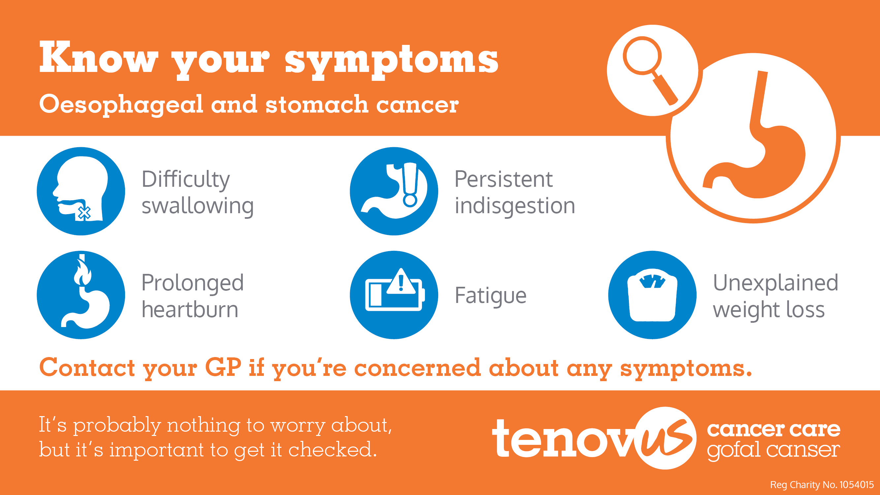
Symptom Awareness, oesophageal cancer
Symptom awareness of oesophageal cancer lower in more deprived communities.
Symptom awareness of oesophageal cancer lower in more deprived communities.

Slide 10
Ethnicity data in cancer statistics
Explored all usual data sources:
Welsh Cancer Intelligence and Surveillance Unit (WCISU)
Systemic Anti-Cancer Therapy Dataset (SACT)
Suspected Cancer Pathway Monthly (SCPM)
Cancer Network Information System (CNIS / CANISC)
Engaged with Equalities Evidence Unit
Engaged with Head of Hospital Statistics
Engaged with Digital Healthcare Wales Single Cancer Pathway Team

Slide 11
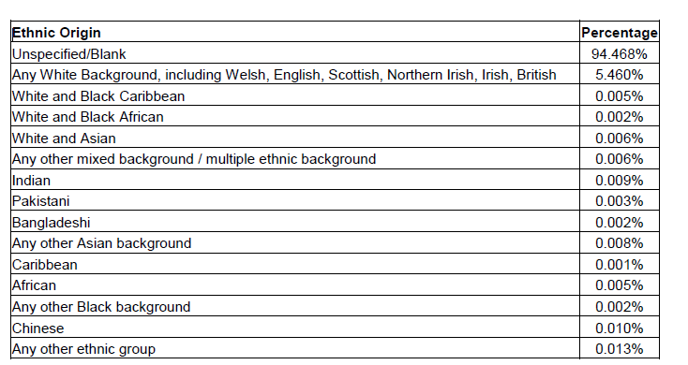
Freedom Of Information Request
percentage of registered cancer patients within the Health Board have recorded ethnicity information within their records?
 | Powys | Aneurin Bevan | Swansea Bay | Cwm Taf Morgannwg | Betsi Cadwaladr | Cardiff and Vale | Hywel Dda | Velindre
General patients | 15.3% | 31.3% | 54.8% | 5.5% | 33.17% | 18.6% | 27.0%
Cancer Patients | 48.25% * |  | 56.65% | 15% |  |  | 41% | Data not held
 | * not treated in Powys, but Powys residence

Slide 12
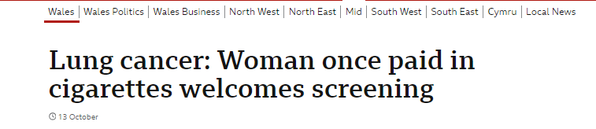
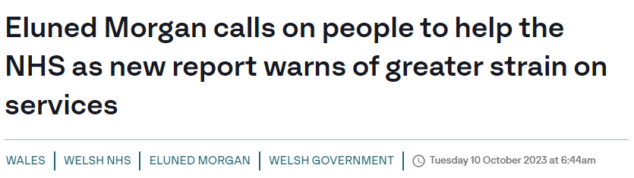


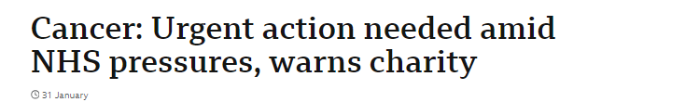
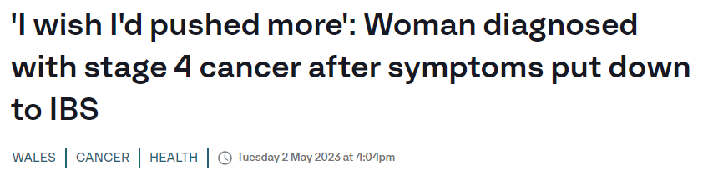

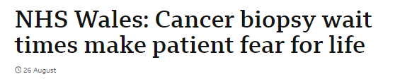
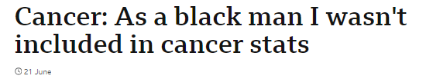
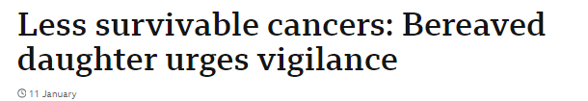

Using data and stats to raise our profile
Since Jan, we’ve had 500 pieces of coverage with a total reach of 330 million.
Notes:
12

