Slide 1


Slide 3


Slide 4
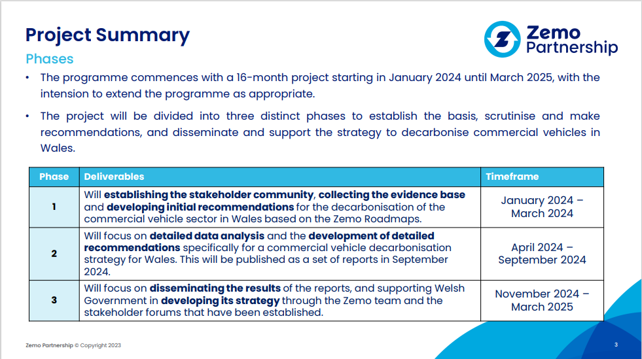

Slide 5
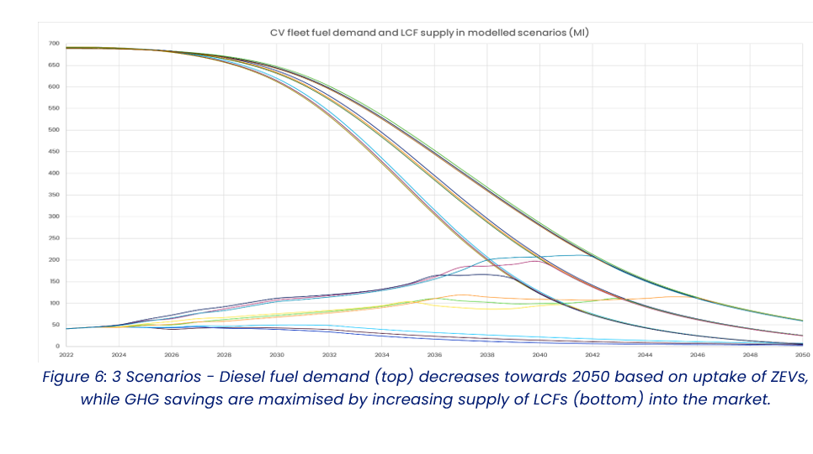

Slide 6
Low Carbon Fuels (LCFs)
LCFs will be an important pathway to decarbonise heavy duty vehicles, in particular long-haul trucks, during the transition to zero tailpipe emission propulsion technologies.
Increase the RTFO target and transition to a GHG emissions target.
Support the wider availability of high blend LCFs in the national bunkering network for HDVs.
Make high-blend low carbon fuels financial attractive
Maximise opportunities to exploit regional biomass waste and residues in Wales and encourage local LCF production

Slide 7
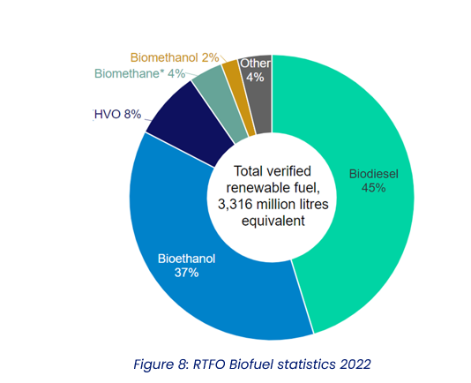
Under the RTFO, renewable fuels made up 6.8% of total road and NRMM fuel in the UK in 2022, saving a total of 7,177 kt CO₂e.

Slide 8
Biomethane & Welsh Agriculture
Biomethane is a growing market for long haul trucks in Wales and wider UK with Well-to-Wheel greenhouse gas benefits and favourable total cost of ownership. There is an opportunity for Welsh farmers and agricultural producers to benefit from this growing market by taking farm waste and generating biomethane through anaerobic digestion. This can also be used to decarbonise farm vehicles and machinery.

Slide 9
Next steps
WG to review draft report
Zemo to publish
Comms opportunities
WG response
Next steps
Phase 3 and consideration of actions

