Slide 1
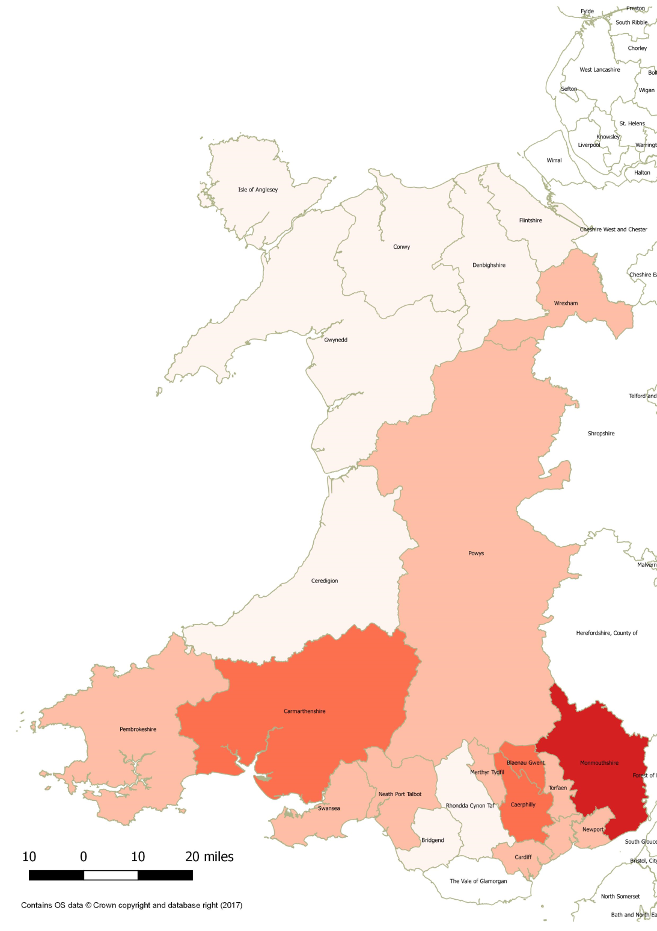

Percentage of schools in Wales by Local Authority who have received first aid training in 2017 from British Heart Foundation, British Red Cross and St John Cymru-Wales (figures accurate as of March 2017)
Local Authority | %
Monmouthshire | 61.5%
Caerphilly | 53.3%
Blaenau Gwent | 50.0%
Carmarthenshire | 41.5%
Torfaen | 39.4%
Newport | 36.8%
Merthyr Tydfil | 33.3%
Powys | 30.4%
Cardiff | 26.1%
Swansea | 24.2%
Neath Port Talbot | 22.4%
Pembrokeshire | 22.4%
Wrexham | 21.7%
Denbighshire | 14.5%
Rhondda Cynon Taf | 12.8%
Ceredigion | 12.2%
Flintshire | 8.6%
Bridgend | 8.3%
Vale of Glamorgan | 7.3%
Isle of Anglesey | 3.8%
Gwynedd | 3.6%
Conwy | 3.0%
0 – 20%
21 – 40%
41 – 60%
61 – 80%
81 – 100%

