Slide 1
Learning life saving skills in school
By the British Heart Foundation Cymru, British Red Cross Wales & St John Cymru

Slide 2
The British Red Cross Wales (BRC), St John Cymru and British Heart Foundation Cymru (BHF) believe that every child should have the opportunity to learn first aid skills, including CPR, before they leave school.

Slide 3
Why?
First aid can save lives. Up to 59% of prehospital deaths from injury could have been prevented with basic first aid, such as applying pressure to bleeding and turning someone on their side and tilting their head back to open the airway.
There are over 30,000 out of hospital cardiac arrests in the UK every year – less than 1 in 10 people survive.
The immediate initiation of CPR (cardiopulmonary resuscitation) can double the chances of survival in some cases. According to BHF research, if we could match survival rates found in parts of Norway where CPR is routinely taught, we could save an additional 5,000 lives per year in the UK.
However, almost 60% of children have no first aid education whatsoever.
Over 300 schools in Wales have community defibrillators according to the WAST online list.
Wales Out of Hospital Cardiac Arrest Plan and the Kerslake review following the Manchester Arena bomb - citizens are our first responders in the event of OHCA and emergencies.
It is a life skill and supports the development of character, resilience and ability to cope with adversity and crises throughout life.
Learning first aid can improve young people’s life chances and empower them to step forward to help others in a shared society.
First aid is easy and fun to teach and learn, and simple to do.

Slide 4
Out of Hospital Cardiac Arrest Plan (2017)
The time to initiating CPR is critical to the outcome for OHCA
Bystanders/citizens are first on scene before medical services
Create a future generation of life savers and increase the number of bystander CPR interventions
Recommendations:
Increased access to CPR training
Increase bystander CPR
Actively promote CPR training and how to use a defibrillator

Slide 5
The Kerslake Review (2018)
During major incidents…the public will likely become a key source of direct assistance for both the injured and for the emergency services
Some members of the public and other responders did not appear familiar with first aid principles and/or were attempting to use more complex major-trauma procedures without sufficient knowledge (e.g. applying tourniquets, use of defibrillators).
We should not be over-reliant on public [statutory] responders in these situations and that, therefore, it would be of great benefit if there was a greater public awareness of basic first aid principles.
Recommendation:
The Government should increase its support for public first-aid training programmes (including those for children and young people).

Slide 6
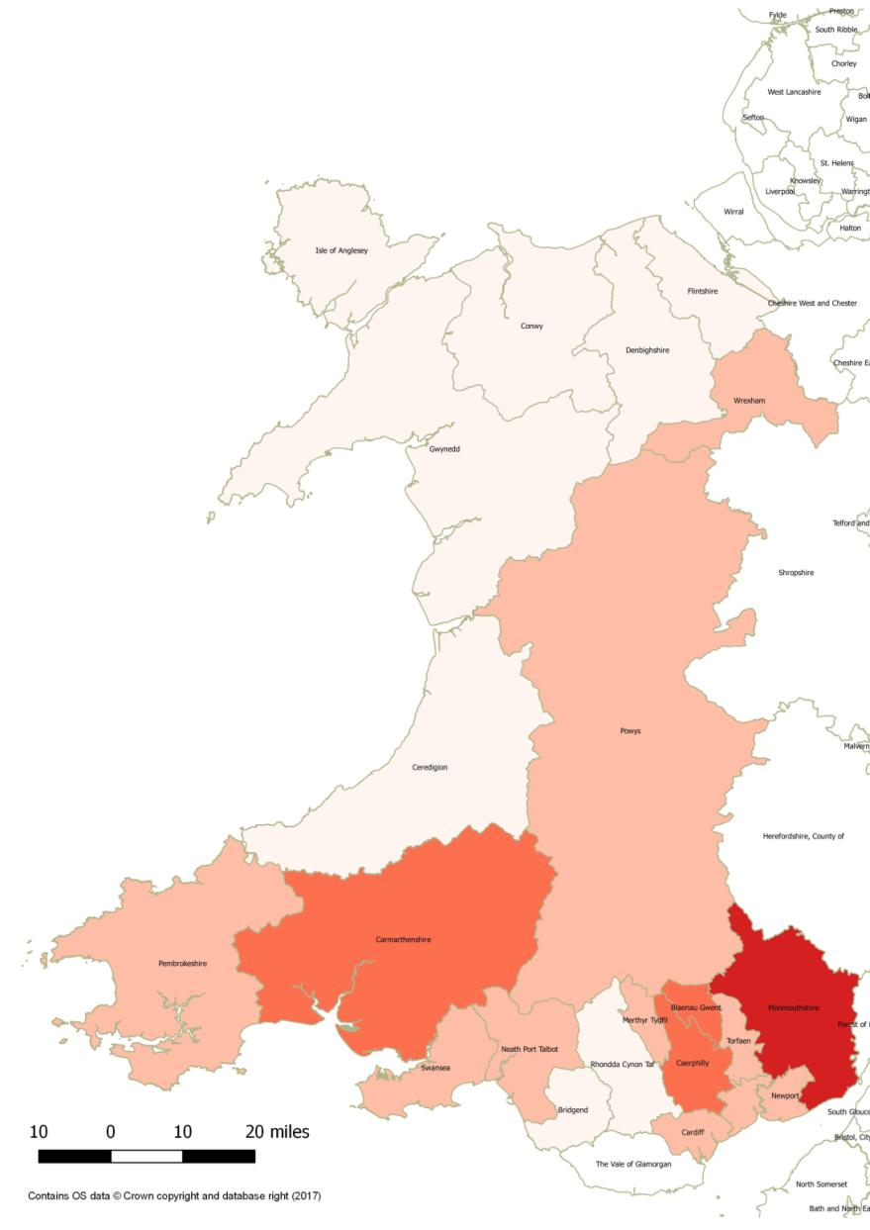

Percentage of schools in Wales by Local Authority who have received first aid training in 2017 from British Heart Foundation, British Red Cross and St John Cymru-Wales (figures accurate as of March 2017)
Local Authority | %
Monmouthshire | 61.5%
Caerphilly | 53.3%
Blaenau Gwent | 50.0%
Carmarthenshire | 41.5%
Torfaen | 39.4%
Newport | 36.8%
Merthyr Tydfil | 33.3%
Powys | 30.4%
Cardiff | 26.1%
Swansea | 24.2%
Neath Port Talbot | 22.4%
Pembrokeshire | 22.4%
Wrexham | 21.7%
Denbighshire | 14.5%
Rhondda Cynon Taf | 12.8%
Ceredigion | 12.2%
Flintshire | 8.6%
Bridgend | 8.3%
Vale of Glamorgan | 7.3%
Isle of Anglesey | 3.8%
Gwynedd | 3.6%
Conwy | 3.0%
0 – 20%
21 – 40%
41 – 60%
61 – 80%
81 – 100%

Slide 7
The four key purposes of the new curriculum:
Ambitious, capable learners – Learning life-saving skills is a life skill relevant throughout their lives in any situation (personal, work-life, wider society).
Healthy, confident individuals – Learning life-saving skills develops an individual’s ability and confidence to act in the event of an emergency protecting the health and safety of themselves and those around them.
Ethical, informed citizens – Learning life-saving skills is a skill which can be used anywhere, in Wales and around the World. It builds on a person’s propensity to act in another’s best interest and encourages humanitarian action.
Enterprising, creative contributors – Learning life-saving skills enables learners to widen their knowledge and potentially influence their vocational aspirations.

Slide 8
Health and Well-being AoLE
WMS 3: Our decision making impacts on the quality of our lives and others
Knowledge, Skills and Experiences:
Knowledge
Decisions can affect our physical health and well-being
Choose to work in a wide range of career opportunities
Seeking support and information to support positive decision making and personal safety
Skills
Take steps to support their health and well-being and that of others in an emergency
Identify and manage risks in making decisions
Make safe decisions when travelling on and near roads
Keep safe in and around water
Take steps to support their health and well-being and that of others in an emergency

Slide 9
Progression steps
Link relevant skills and knowledge to a thread through the progression steps around staying safe and responding in a life saving emergency?
Keep safe in and around water
Make safe decisions when travelling on and near roads
Take steps to support their health and well-being and that of others in an emergency
For example?
PS1 – I know how and when to get help in a life saving emergency at home.
PS2 – I know how and when to get help in different life saving emergency situations.
PS3 – I can recognise when someone’s life is at risk. I am confidently able and willing to perform basic life-saving skills whilst knowing the importance of keeping myself and others safe.
PS4 – I understand the importance of acting in a life saving emergency. I am confidently able and willing to perform basic life saving skills in a number of different scenarios.
PS5 – I understand my responsibility and the responsibility of others to act in a life saving emergency. I am confidently able and willing to perform basic life saving skills in a range of situations and can actively encourage other people to help.

Slide 10
Resources available to support schools:
British Red Cross (www.redcross.org.uk/education)
Life.Live it. (Ages 6-11):
The Life. Live it. resource is simple to use and requires no specialist knowledge of first aid.
It is a web-based, free teaching resource which enables primary schools to deliver first aid education to pupils and it gives them the tools and information they need to feel comfortable in doing so.
Interactive activities, film scenarios, information sheets and online quizzes.
Educator introduction (Ages 11-16)
Supports educators to deliver first aid education that will help young people develop the knowledge and confidence to act in a first aid emergency. A first aid kit isn’t necessary to deliver any sessions. The resource shows and gives examples of how everyday items can be used in an emergency. For example, a t-shirt can be used to put pressure on a bleeding wound or water to cool a burn. The resource features 16 first aid skills, which are explored using realistic scenarios relevant to young people.
Interactive content including: films, written case studies, photos, animations, role plays and activities. Young people can use the website independently, or engage with first aid learning through facilitated activities. This flexible approach can be adapted for a range of different ways of learning, settings and abilities.
The website offers a number of tools to evaluate learners’ confidence and knowledge before, during and after first aid sessions.

Slide 11
St John Cymru – Wales (https://training.stjohnwales.org.uk/schools-pupil-training/)
Young Life Saver Scheme
St John have created the Young Lifesaver Award Scheme for young people aged 7 to 16 years.
All courses can be delivered by teachers, higher level teaching assistants, school nurses, club coaches or youth club leaders who have a current first aid qualification.
All materials are available to download via the website. The course is split into modules to allow for ease of teaching. Each module contains an easy to follow lesson plan, subject specific fact sheet and PowerPoint presentation. Many of the modules have worksheets, scenario cards, case studies and videos.
Pupils who successfully complete the award are sent a Young Lifesaver certificate that they can keep in their Record of Achievement files. As well as achieving First Aid skills the scheme allows young people to gain numerous personal skills such as the ability to be assertive, to make decisions, to work independently and co-operatively whilst increasing their self-confidence.
Young Life Saver Junior Award – this award is available to young people between the ages of 7 to 11.
Young Life Saver Senior Award – this award is available to young people between the ages of 11 to 16.
Young Life Saver Sport Award – This award is available to all young people between the ages of 7 to 16.
This scheme is also supported by the St John Cymru – Wales’ Schools Award.

Slide 12
British Heart Foundation (https://www.bhf.org.uk/heart-health/how-to-save-a-life/cpr-kits/cpr-training-for-schools)
Call, Push, Rescue - CPR training for schools
The British Heart Foundation offer free CPR kits to schools. CPR kits are free for eligible secondary schools, sixth forms and colleges. The training is suitable for students 12 years old and over. Schools can apply for one CPR kit.
One CPR kit will allow you to train 35 pupils at a time and is reusable.
No instructor is needed as all of the techniques are taught using videos. All you need is a DVD player and a little space to practice in.
The CPR training kit includes 35 reusable inflatable manikins; 35 kneeling mats; 35 red inflation bags; 35 practice-while-watching training DVDs; 2 manual inflation pumps; cleaning wipes; extra manikin replacement parts; all contained in 3 handy carry bags.
The CPR training kit covers:
How and when to perform CPR on an adult or child
Put someone in the recovery position
Use a public access defibrillator

Slide 13
Thank you

